Slide 1
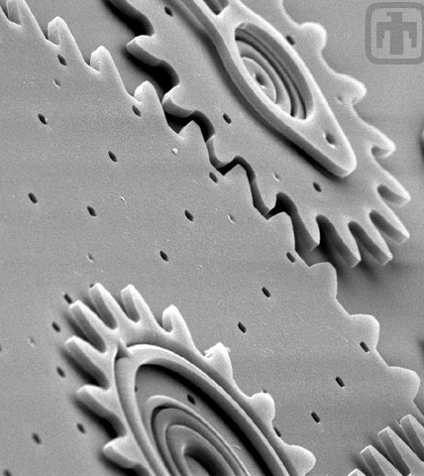
An Introduction to MEMS
Kimberly Bourland
October 23, 2018
Notes:
Overview:
What are MEMS?
How are they made?
Types of MEMS
Current challenges
Future of MEMS

Slide 2
Microelectromechanical Systems
Combine electrical and mechanical components
Inertial sensors, optical devices, microphones, microfluidic devices, flow sensors, pressure sensors, IR sensors
https://mems-iss.com/mems-technologies/
Notes:
Characteristic length
$1 μm$ to $1 mm$

Slide 3
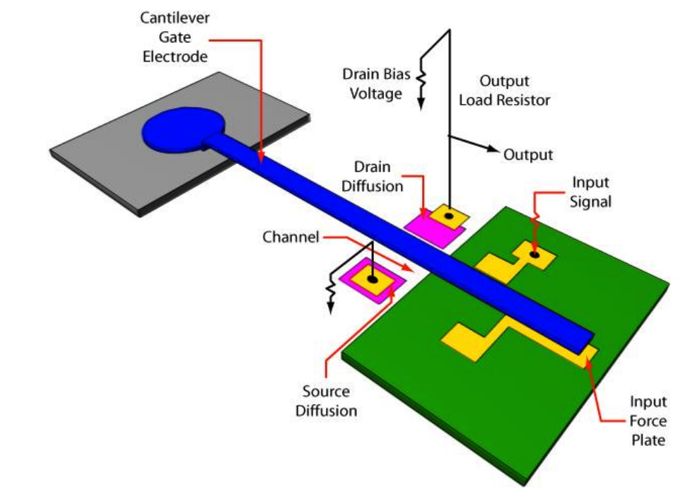
Early MEMS
1954 – C. S. Smith noted Si and Ge were piezoresistive materials
1964 – Harvey Nathanson and team fabricated resonant gate transistor (RGT)
1982 – Kurt Peterson published ”Silicon as a Mechancial Material”
Southwest Center for Microsystems Education (SCME) App_Intro_PK10_PG_May2017.docx
Notes:
Piezoresistive effect = change in electrical resisitviity of a SC/metal when mech strain is applied
Different than piezolectric (only changes resistance)
Became gages
It served as a frequency filter for integrated circuits by transmitting only those signals within the designed range to an output circuit while ignoring all other frequencies. The RGT was unlike conventional transistors in that it was not fixed to the gate oxide. Instead, it was movable and cantilevered with respect to the substrate. Electrostatic attractive forces controlled the distance between the gate and the substrate. The RGT was the earliest demonstration of micro electrostatic actuators. It was also the first demonstration of surface micromachining technique
It was entitled "Silicon as a Mechanical Material". The paper provided information on material properties and etching data for silicon and was instrumental in enticing the scientific community into exploration of these areas. It is one of the most referenced articles in the MEMS field

Slide 4
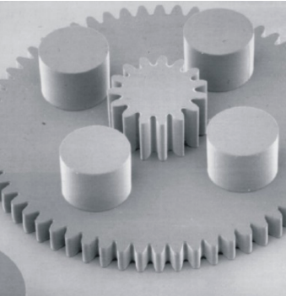
Types of Micromachining
Harmen Droogendijk,
University of Twente, 2009
G. Genolet, et al.
Micromachines 2014, 5, 486-495
Sandia National Labs
Notes:
Surface
LIGA
Bulk
Material properties influence device performance
How to fab depends on structural, sacrificial and maksing materials.
Etch with silocn.

Slide 5
Surface Micromachining
Notes:
8 micron features
Thin machinery
2.5 D
All on surface of the wafer

Slide 6
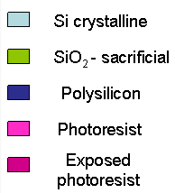
http://81.161.252.57/ipci/courses/technology/inde_374.htm
Notes:
Deposit sacrificial layer (SiO2)
Pattern sacrificial layer
Etch sacrificial layer
Remove resist
Deposit polysilicon (or other material)
Deposit and pattern the material
Etch
Remove resist
Remove sacrificial layer

Slide 7
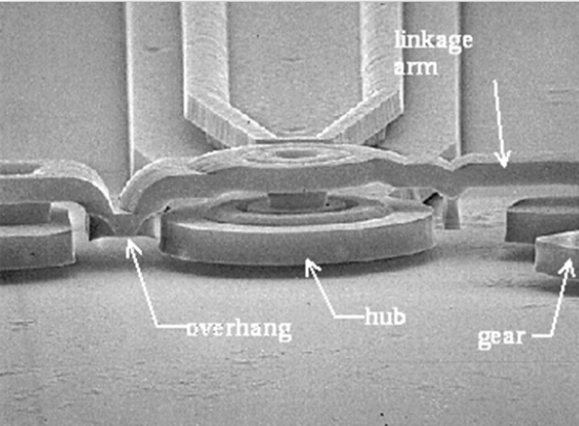
Chemical Mechanical Polishing (CMP)
Sandia National Laboratories
Notes:
Doing layers on layers doesn’t always give clean topography
CREATES BUMPS
Smooth/polish the sacrificial layer before depositing the next layer and get nice smooth appendages.

Slide 8
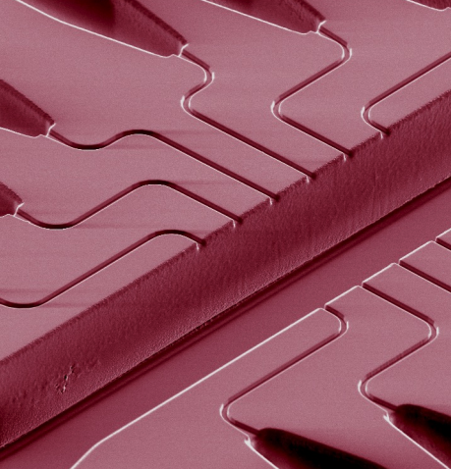
Bulk Micromachining
C. Ionescu-Zanetti, et al (PNAS, 2005)
Notes:
Selectivity etching inside substrate, removing bulk of materia
Subtractive
Etch deep cuts, anisotropic chemistry
High aspect ratios fluidic channels, alignment grooves, nozzles, membranes, pits

Slide 9
http://81.161.252.57/ipci/courses/technology/inde_376.htm
Notes:
Start with wafer
Can dope the surface (or place other film on top)
Back patterning, place resist on back and etch through
Etch
Etch stops at the top layer. (can use an etch stop, timing, etc)
Utilizes current processing methods
Can only wet/dry etch
Wet etch leads to large holes in the back of the substrate

Slide 10
LIGA
http://www.x-ray-optics.de/index.php/en/types-of-optics/refractive-lenses/crls-by-liga
Notes:
lithography, electroplating and moulding
Provides high aspect ratio structures with PMMA
Electroplate PMMA for metal structures
Precise dimensions and good surface roughness
Turbines, springs, gratings, watch parts
Very slow process

Slide 11
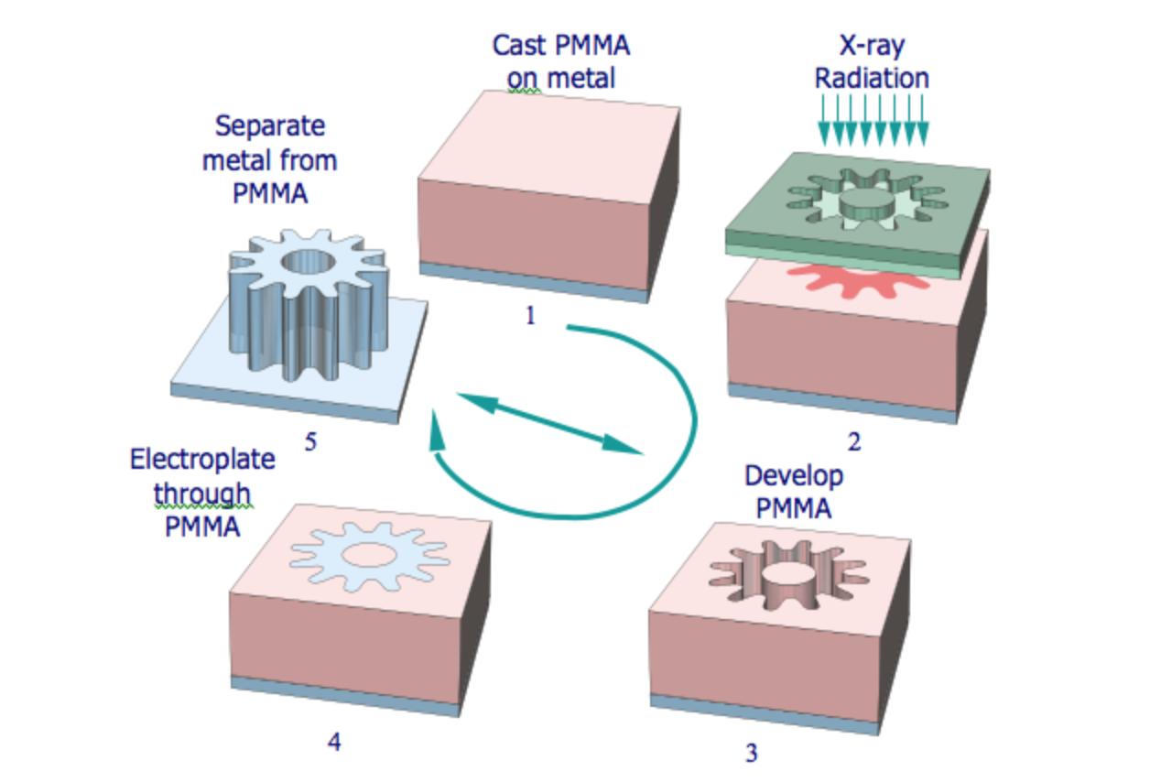
https://www.memsnet.org/about/fabrication.html
Notes:
Getting the x-ray mask is a multi-step process (can be expensive)
Can also use the metal shape created in step 5 to press into PMMA and then electroplate and create metal shape again. (can save money)
Can release from substrate and may have to assemble the device using the various parts.
Electroplating is less than bulk electroplating
Depending on wavelength, can use current UV or xray tech
Will also use CMP to smooth over the electroplated top as well

Slide 12
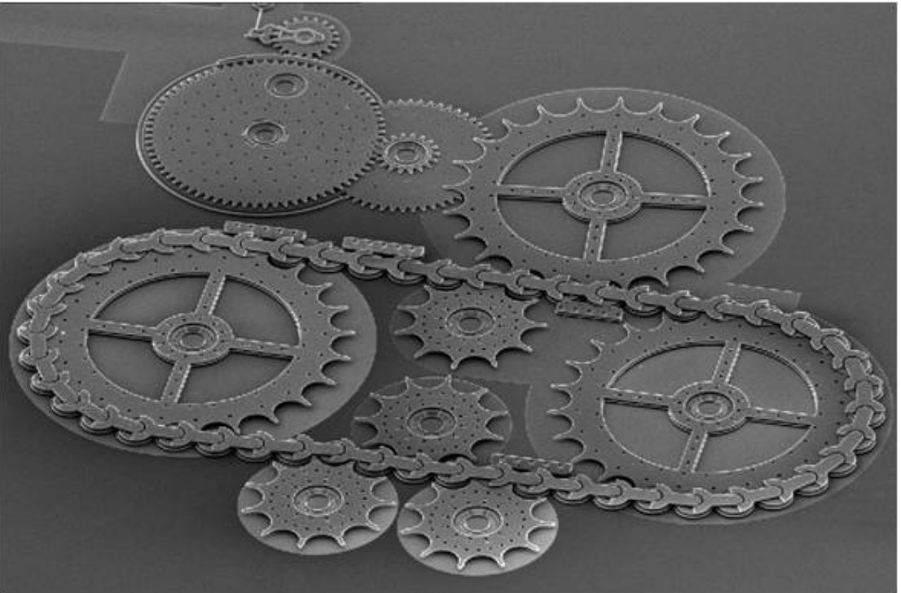
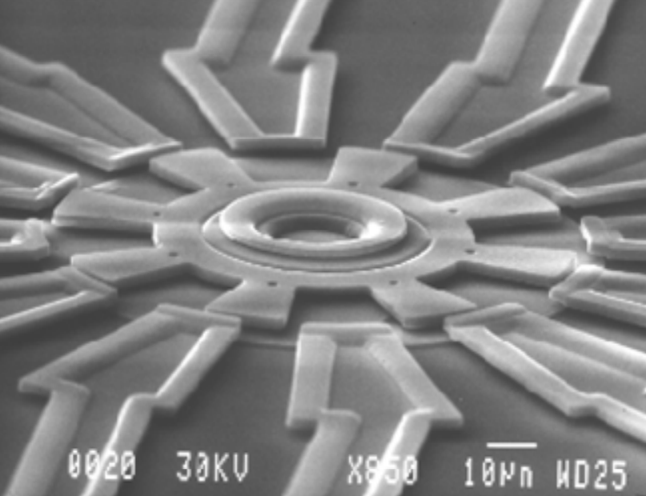
Devices
Sandia National Laboratories
Debiotech and STMicroelectronics
STMicroelectronics
Richard Muller, UC Berkeley
Notes:
Sandia : Created a national lab for surface micromachines. Showing a multilevel device
Debiotech: Insulin pump
Richard Muller: First rotary electrostatic side drive motor
STMicroelectronics: Proof mass with capacitance sensors - accelerometer

Slide 13
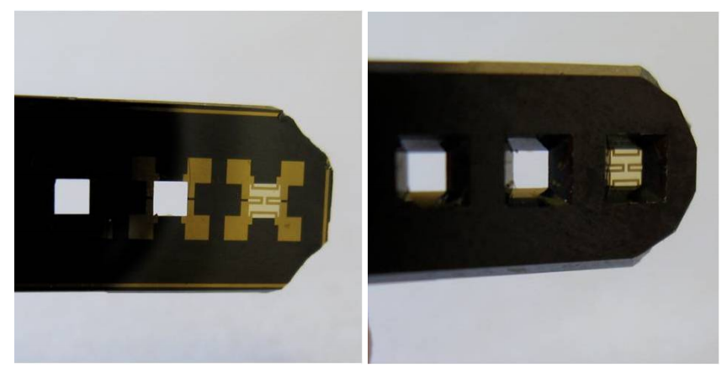
Pressure Sensor
https://www.radiolocman.com/review/article.html?di=148185
UNM/MTTC

Slide 14
Inkjet Printing
https://www.therecycler.com/posts/epson-reveals-secrets-behind-development-of-micro-piezo-technology/
http://www.iut.com.tw/en/Customized-thermal-inkjet-print-head.htm

Slide 15
Accelerometer
http://www.meamsjournal.com
https://www.sensorsmag.com/

Slide 16
Digital Micromirror Device
Texas Instruments
Notes:
Mirrors made of aluminum, reflect light
Each mirror represents one pixel
Number of mirros = resolution
1080p = 2 million mirrors
Tilts either on or off (1 or 0)

Slide 17
Challenges
https://www.bruker.com/

Slide 18
ITRS 2013 MEMS
Notes:
integration aspects
back-end of manufacturing, packaging and test.
As mobile internet device manufacturers work to decrease size and weight, extend battery life, and integrate new functionalities, their pull on MEMS device manufacturers is for smaller package size and integration.

Slide 19
Notes:
Includes overall improvement of sensors
Want to integrate AI, may be complicated of where to put processing chip with sensors, etc.

Slide 20
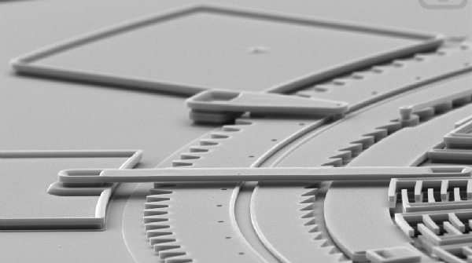
Questions?

